Slide 1
University of Asia Pacific Artificial Intelligence and Expert Systems
Implementation of Multivariable Linear Regression Using a Public Dataset

Slide 2
Problem description: Implementation of a Linear regression model with a dataset and the dataset must be multivariant. At the basis of other parameter we have to predict another parameter. Objective: There are several approach in Machine Learning to predict a data at the basis of other data. In this project we are going to implement “Linear Regression”- model to predict data.

Slide 3
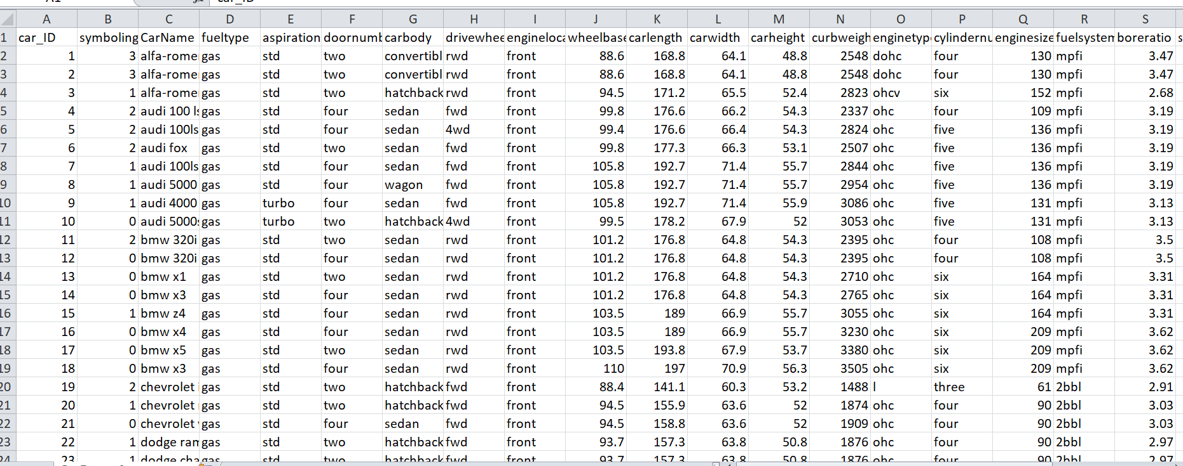
My dataset:

Slide 4
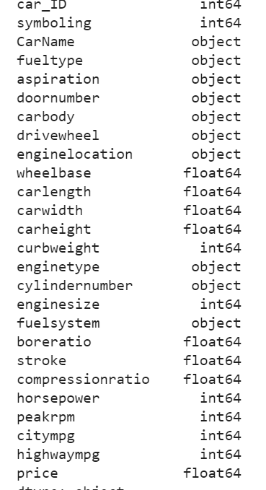
Here is my care type data:

Slide 5
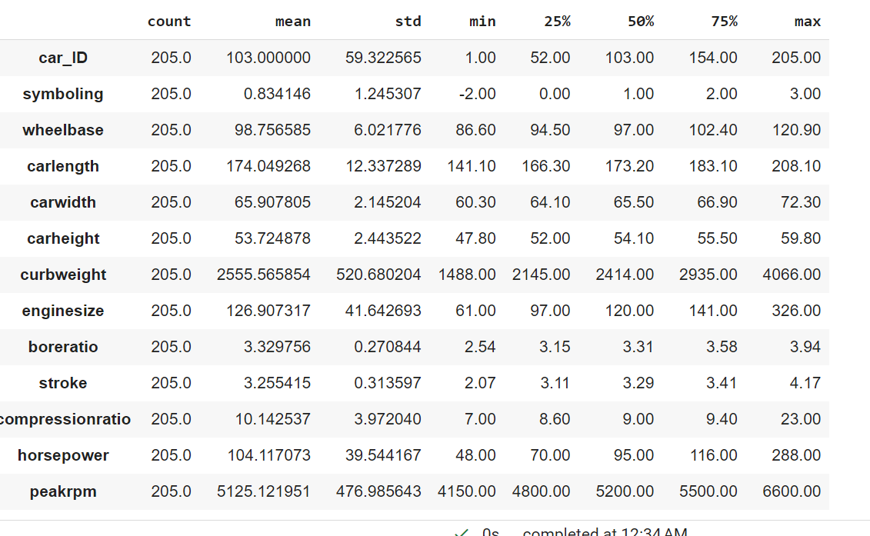
Car describe:

Slide 6
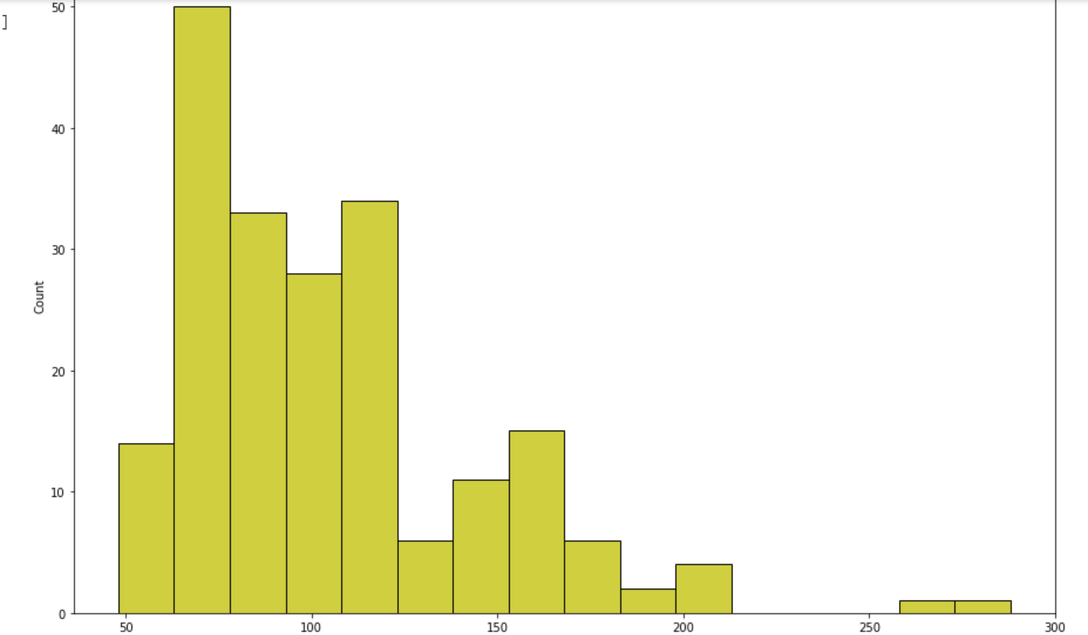
Plot Some Data: Car horse power Distribution plot—Here “X” axis contain horse power and “Y” axis contain count.

Slide 7
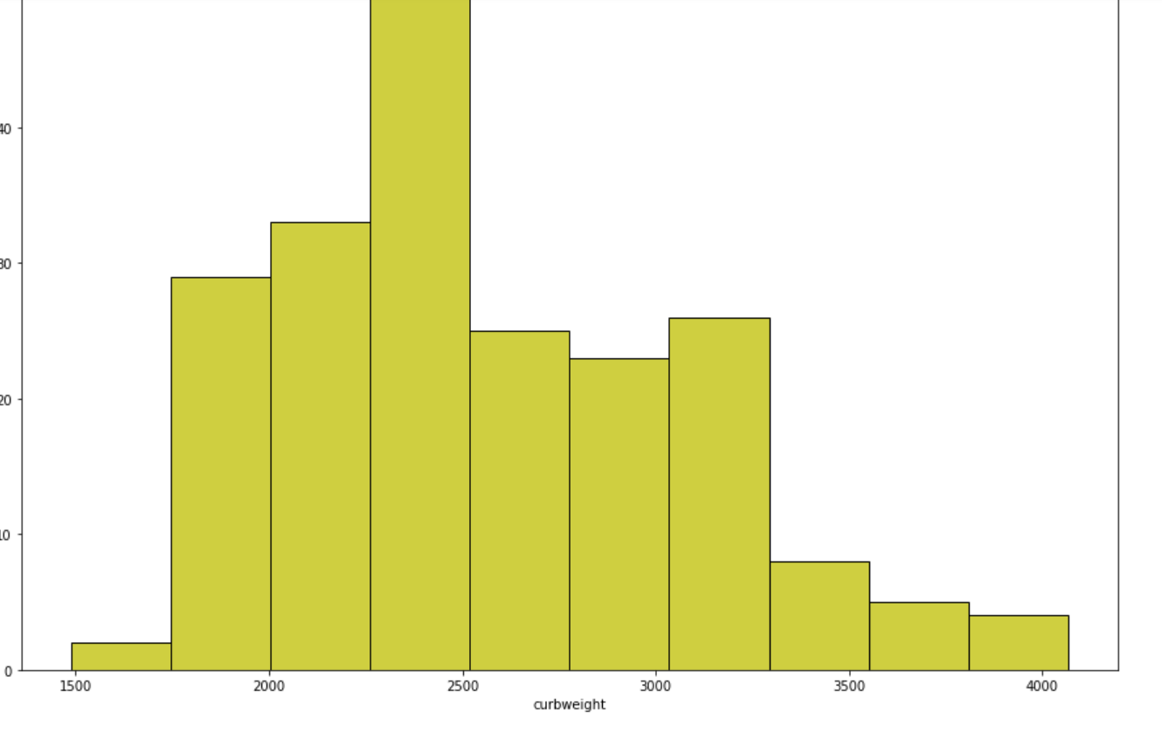
Now,I am ploting car curb weight plot: Here “X” axis contain car curb weight and “Y” axis contain count.

Slide 8
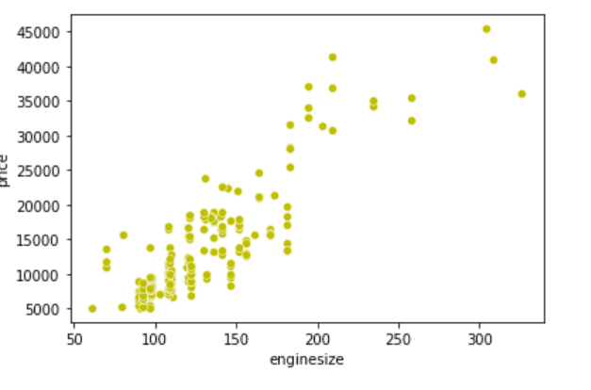
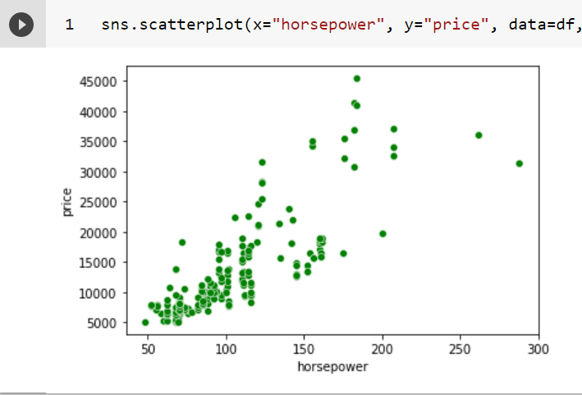
Now, I am showing scatterplot of engine size and horsepower..

Slide 9
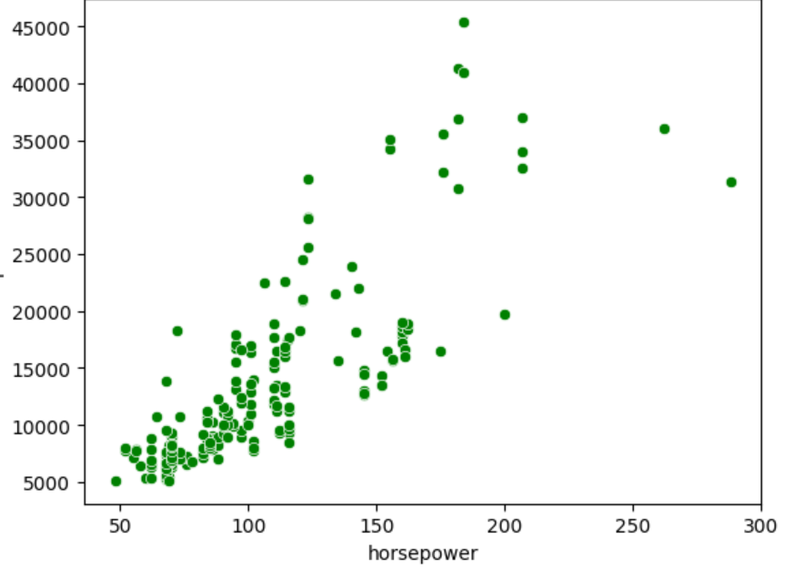
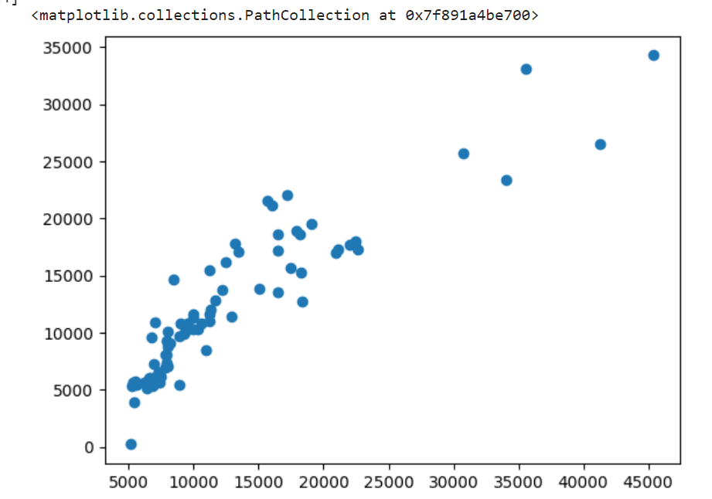
Now, I am ploting scatterplot of horse power and prize. Wher prize contain “Y” axis. And horse power contain “X” axis.

Slide 10
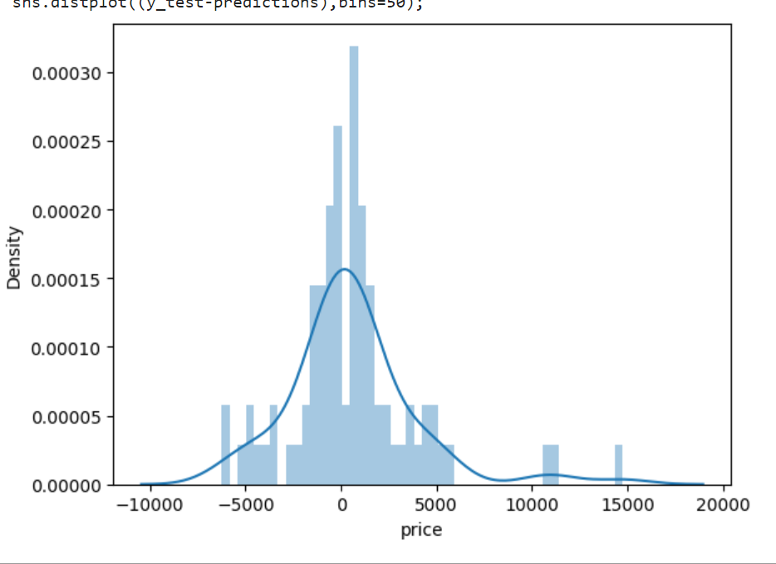
My testing predictionsa:

Slide 11
Conclusion:
In conclusion, we have successfully implemented a Multivariable Linear Regression model to evaluate the performance of Higher Education students. We normalized the data, trained the model using the hypothesis function, cost function, and gradient descent algorithm, evaluated the performance of the model using the cost function, and finally, made a prediction using the model. Further improvements can be made by tuning the hyper parameters and adding more features to the model

Slide 12
THANK YOU

